Slide 1
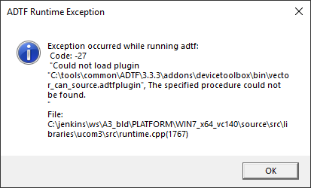
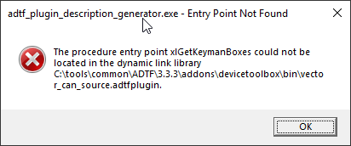
-The original: problem is was in ADTF3, which is caused by ADTF not being able to find some libraries, which are in place in windows explorer, but in ADTF they give missing errors. -Also „demo_can_decoder.cpp” source code is not available, at all. It is built already, but this way there is no way to make any changes in the ADTF3 CAN filter implementation.
1
Internal | Chassis Systems Control | CC-PS/ESY1 | 6/2/2017
© Robert Bosch GmbH 2017. All rights reserved, also regarding any disposal, exploitation, reproduction, editing, distribution, as well as in the event of applications for industrial property rights.

Slide 2
ADTF3 DLL entry point error
-DLL entry points are also giving errors. These are false errors, on the screenshot it is clearly visible that the mentioned .dll file contains the entry point.
All subtasks are set to BLOCKER in Gira.
2
Internal | Chassis Systems Control | CC-PS/ESY1 | 6/2/2017
© Robert Bosch GmbH 2017. All rights reserved, also regarding any disposal, exploitation, reproduction, editing, distribution, as well as in the event of applications for industrial property rights.

